Slide 1
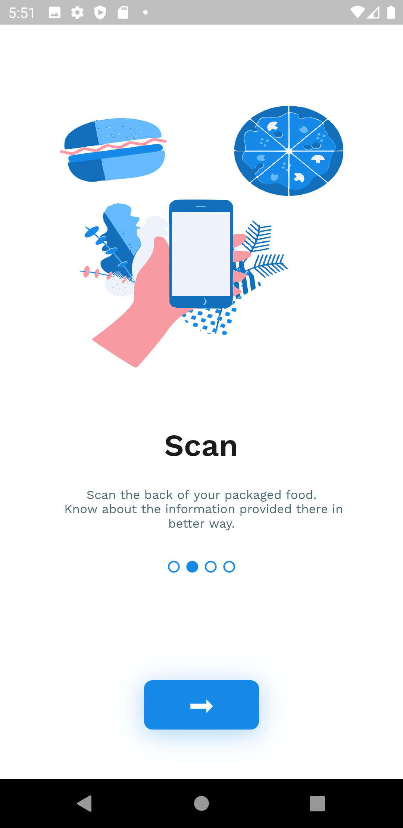
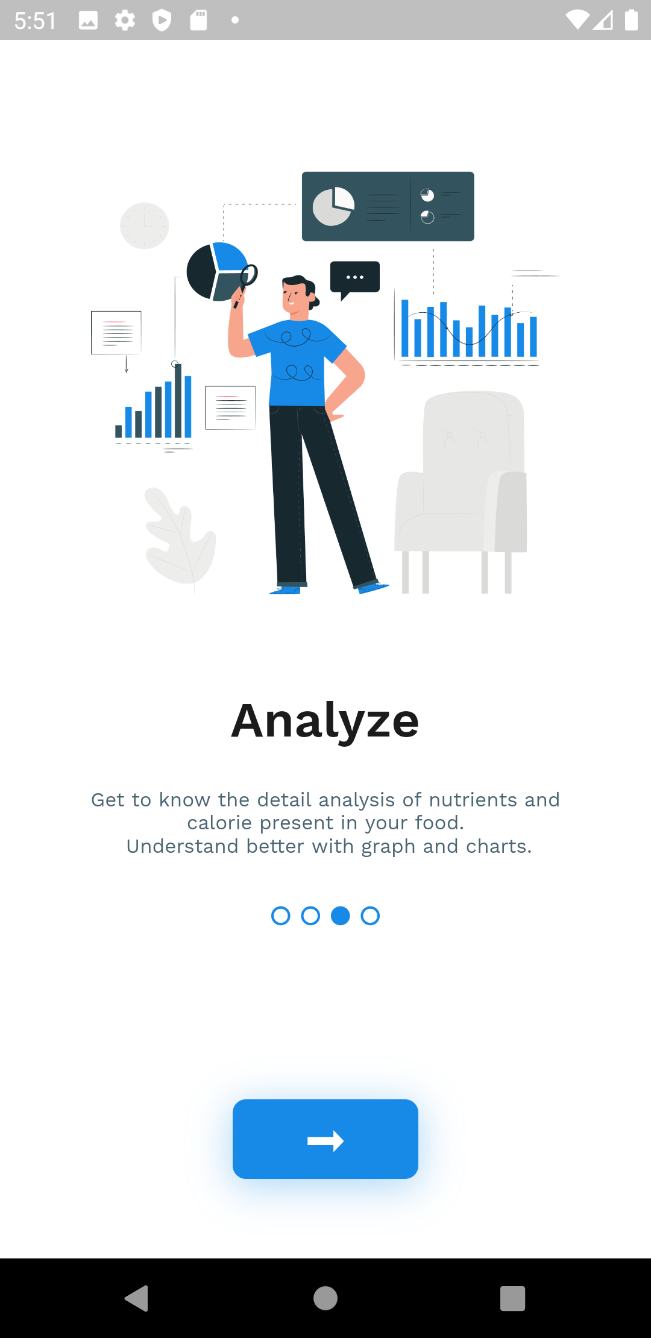
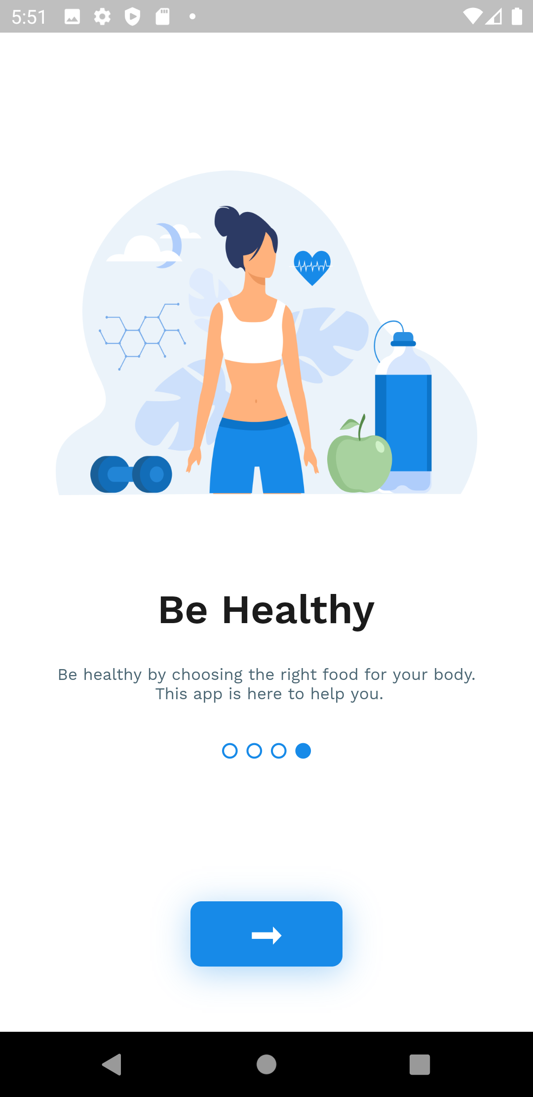
nutri.gram

Slide 2
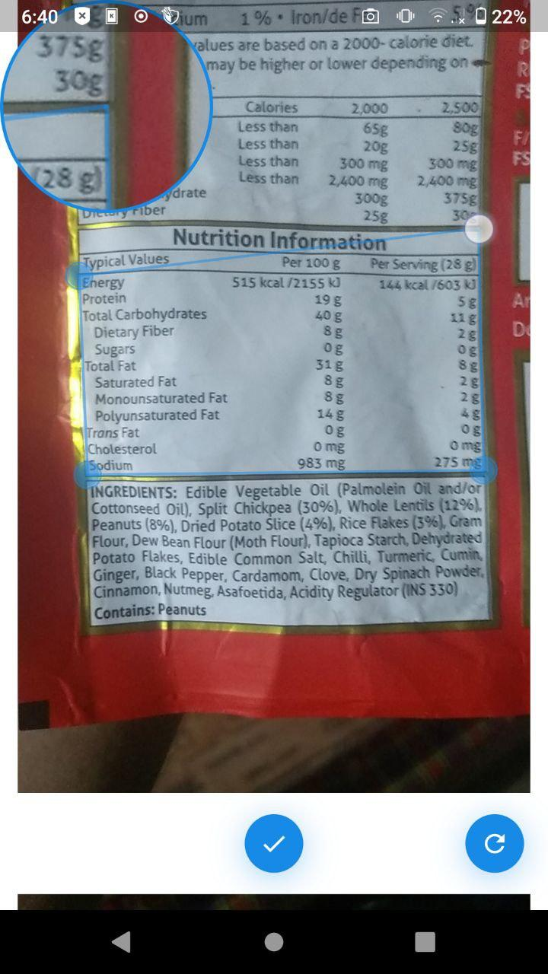
Introduction
Your food choices each day affect your health — how you feel today, tomorrow, and in the future.

Slide 3
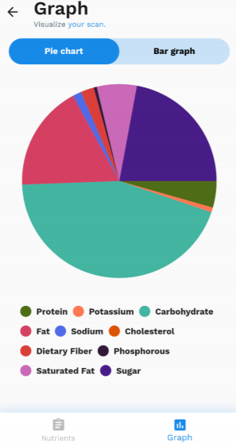
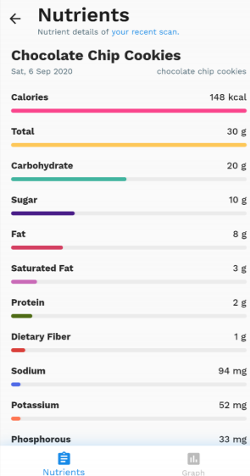
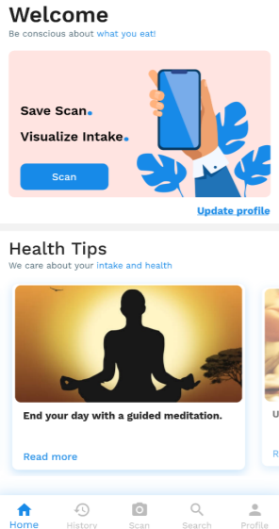
Objectives
To enable users to get information about the nutrients and calories
To display graphs on their calorie and nutrition consumption to track their diet.
To provide health tips

Slide 4
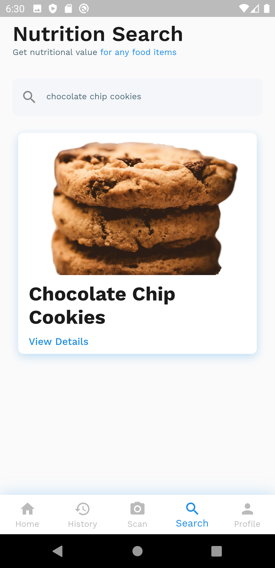
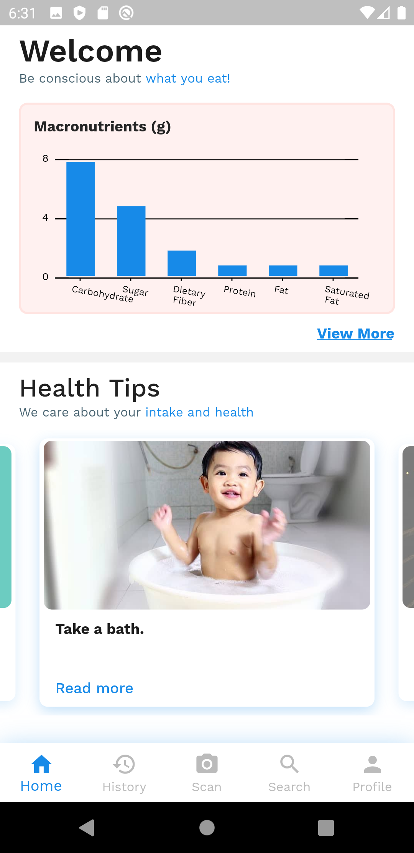
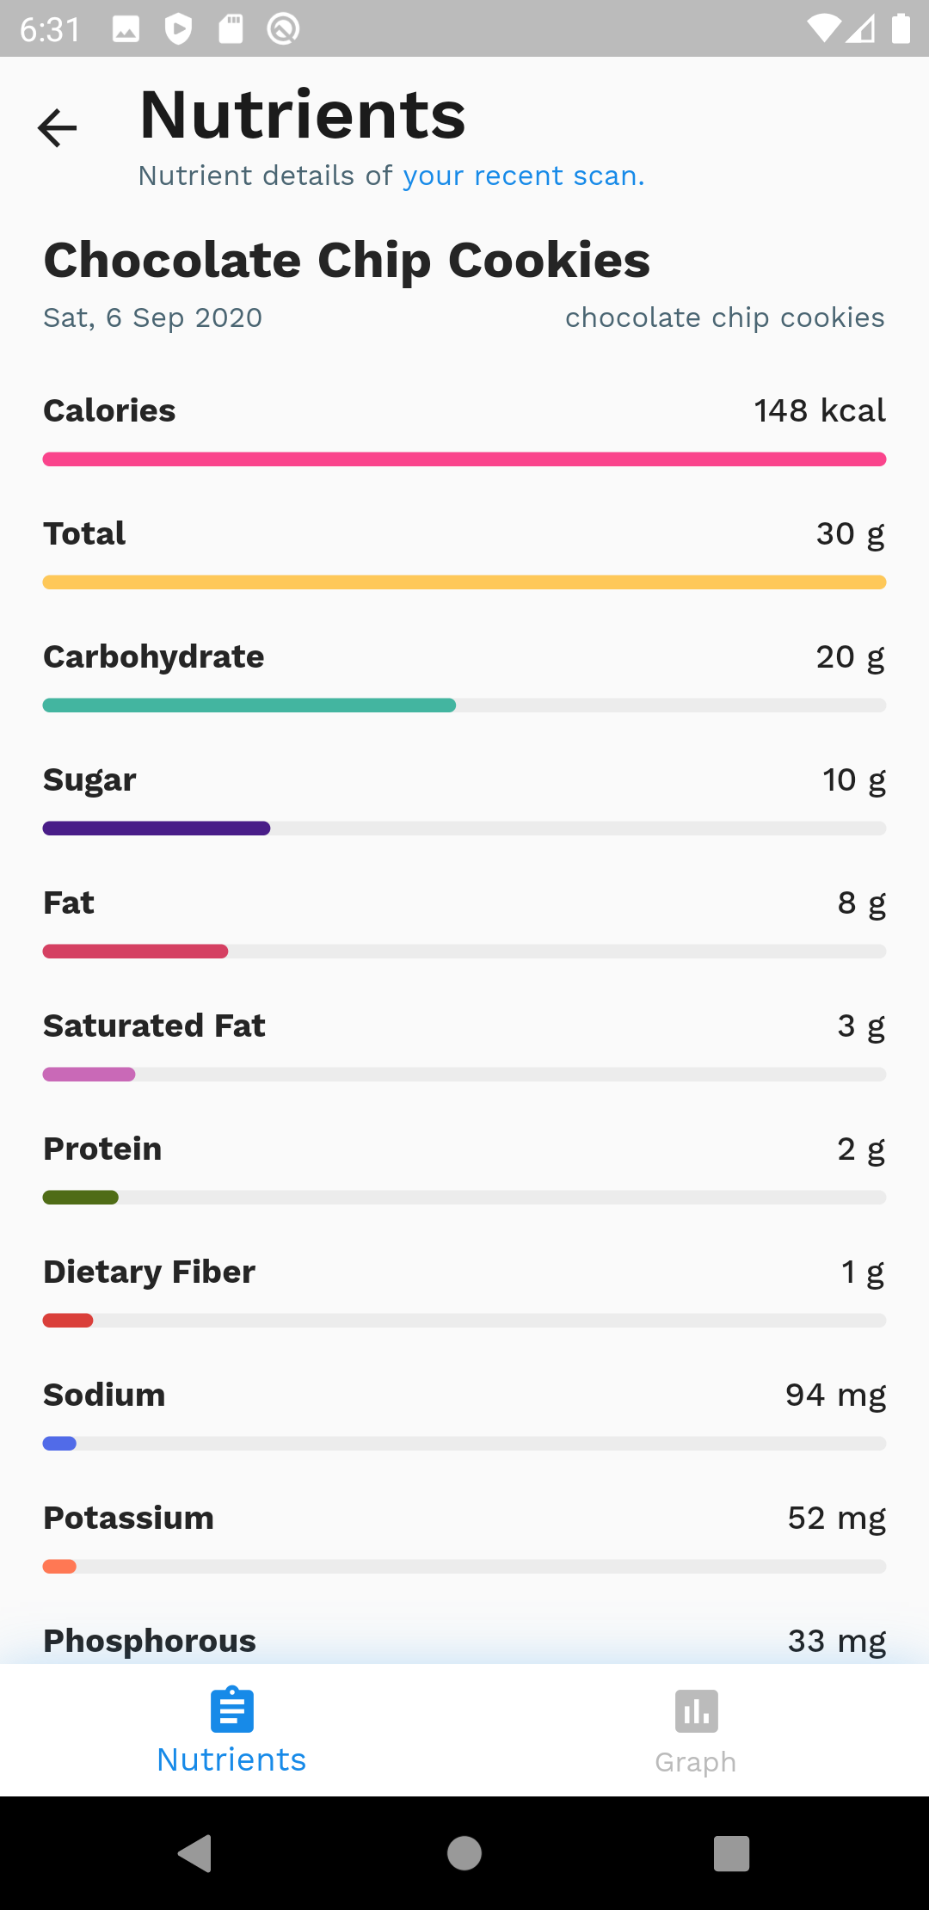
Implementation
Layout of the app (Figma Design)
User authentication
Front End Implementation
Image Processing
Back End API connection
Front End and Back End Merge
Documentation

Slide 5
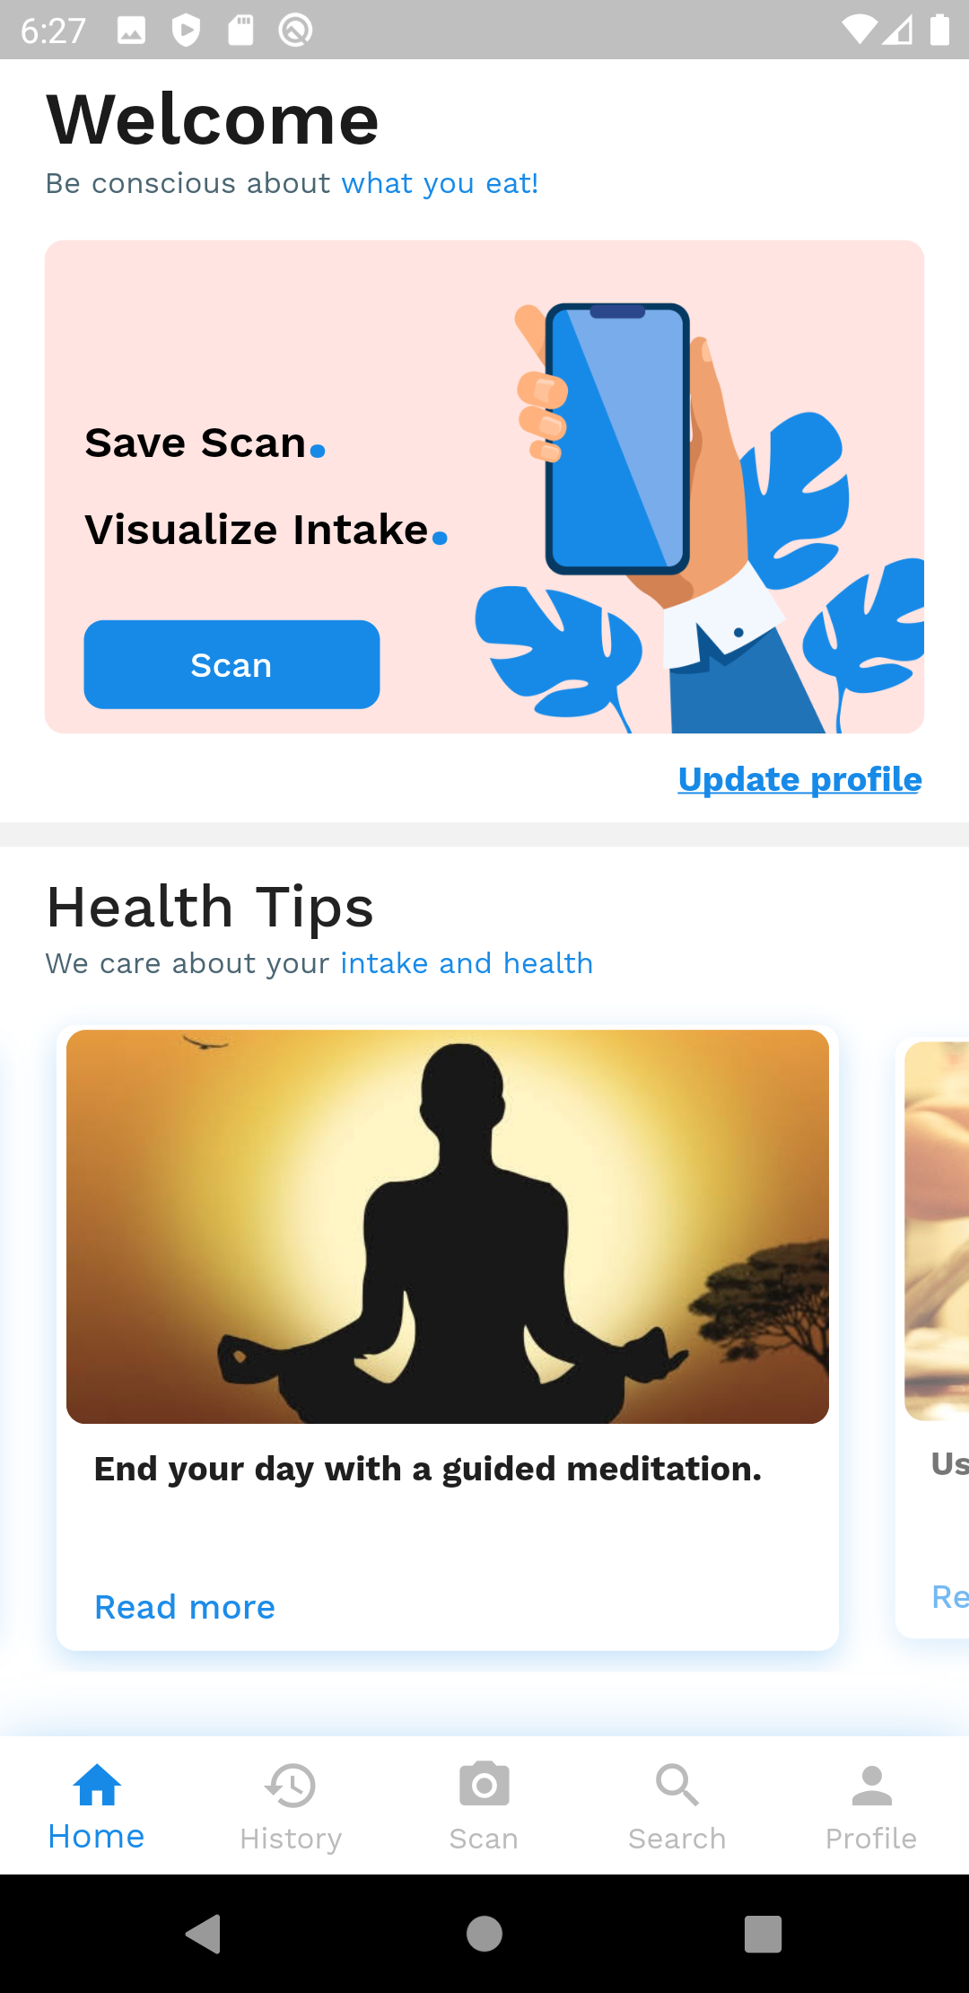
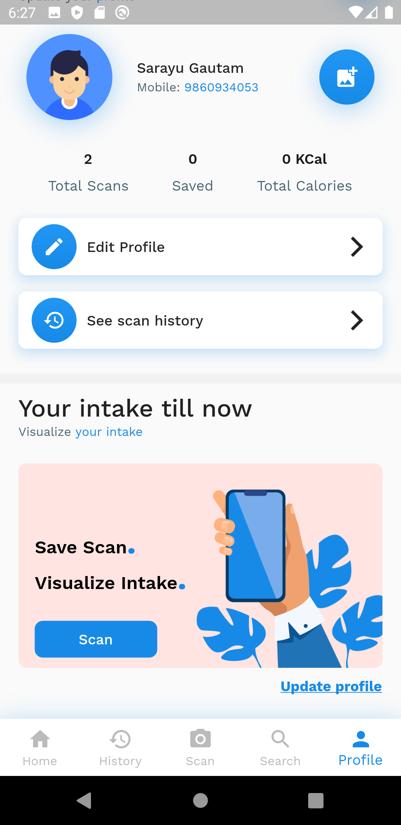
Application flow
Frontend
Designed with Figma
Cross platform development with Flutter
Uses Stacked Architecture
Dart FFI to call OpenCV in Flutter
pie_chart and charts_flutter for visualization
SharedPreferences for Local Storage of data
Dependency Injection with get_it

Slide 6
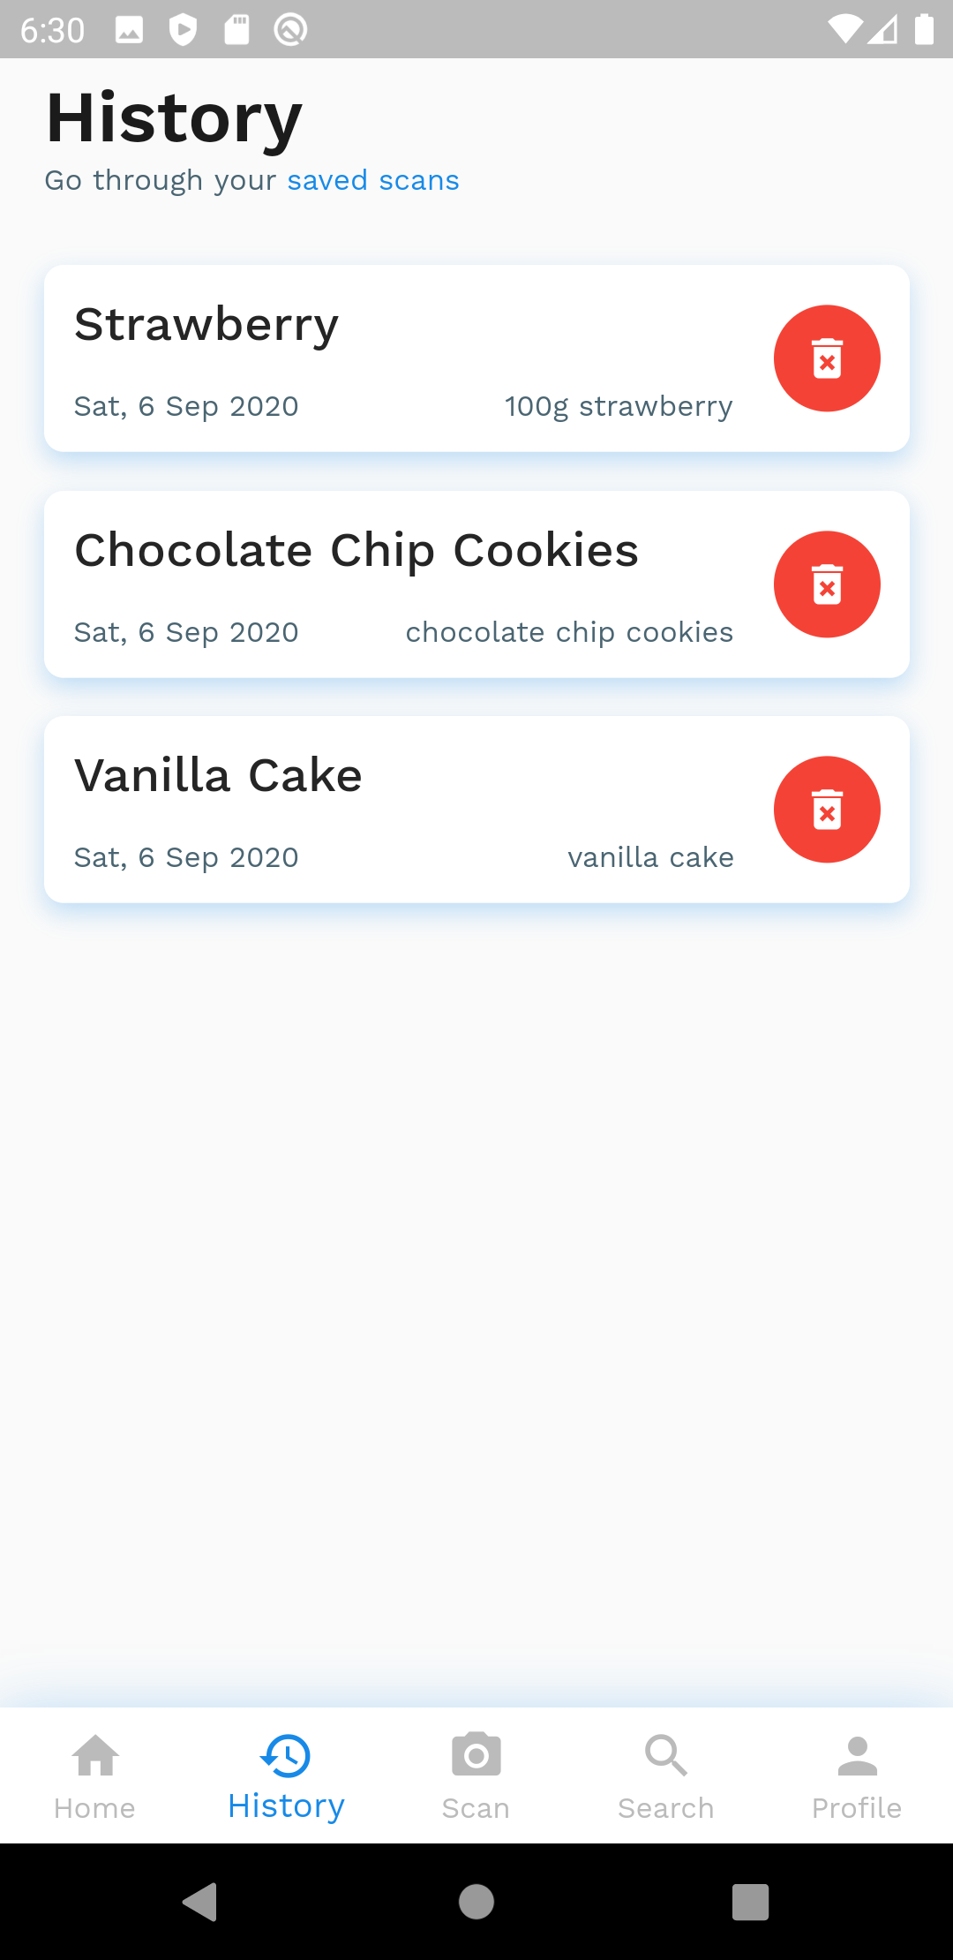
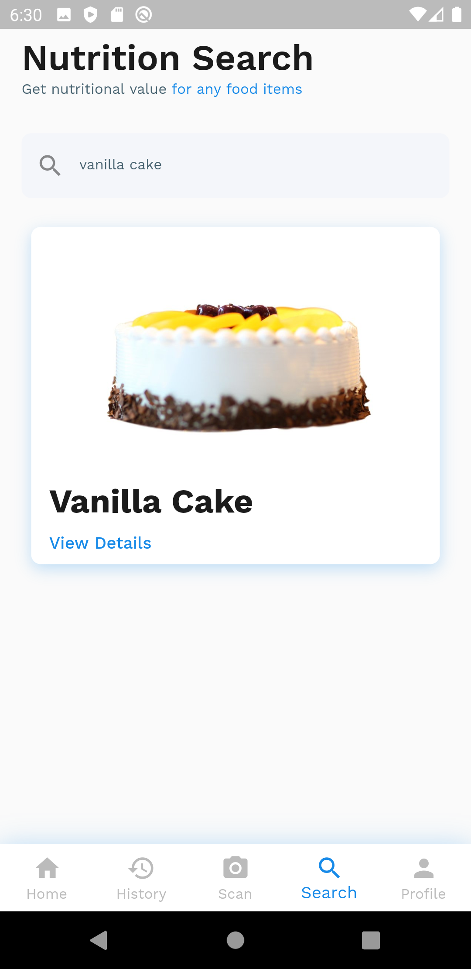
Application flow
Backend
Node.js Express App with MongoDB
Mongoose ODM for model and DB connection
Nutritionix API for search results
JWT token for authentication
Communication with Flask Server for scan results

Slide 7
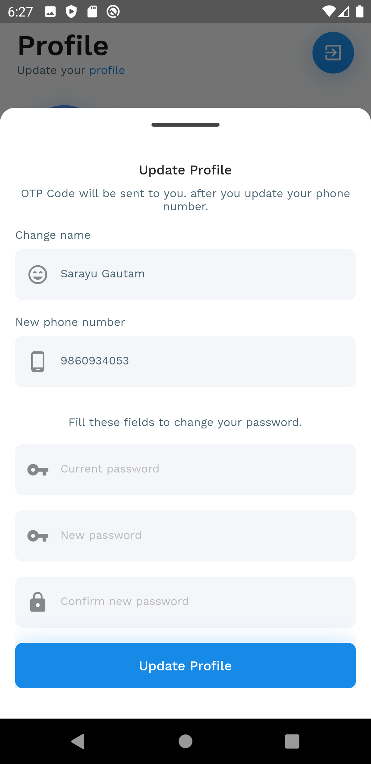
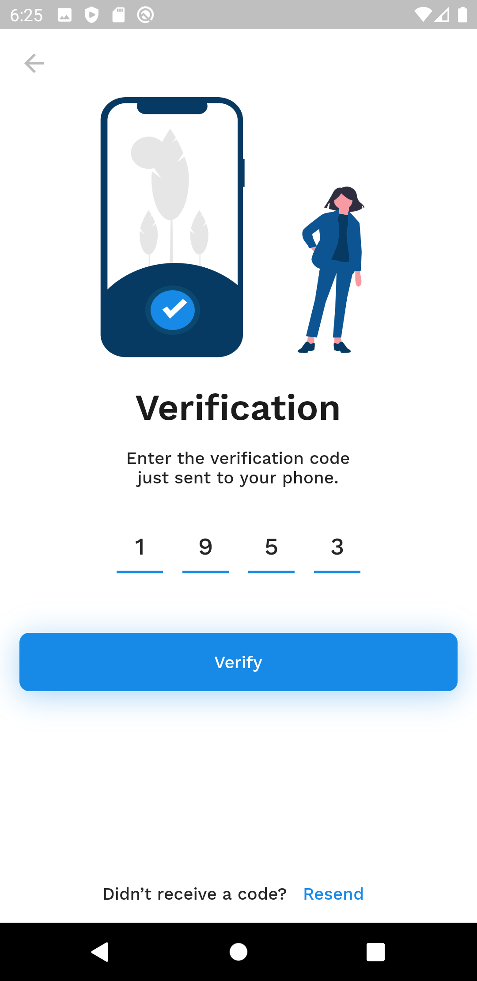
Features
Scan an image
Visualize scan result
Save scan results after logging in
Search if unable to scan
View scan history
Visualize more with graphs
Health tips

Slide 8
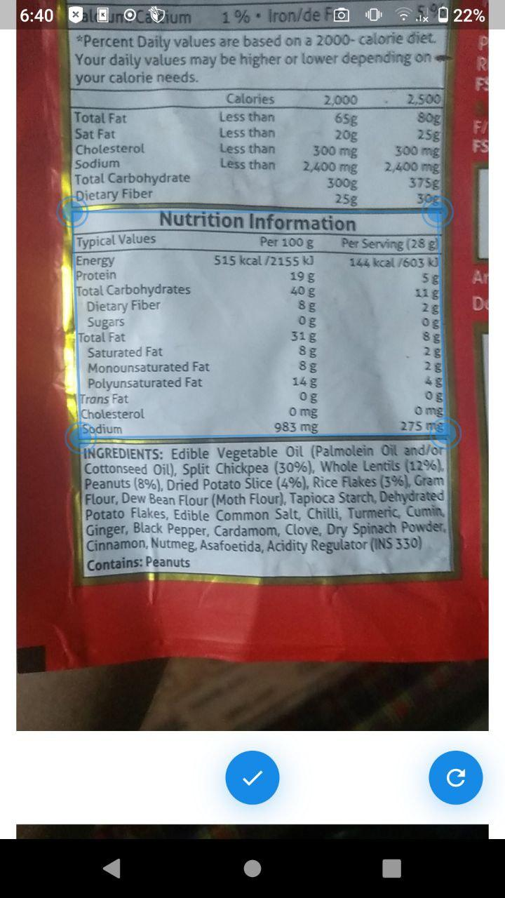
Image Scanning
Nutrition Label Scanning Feature
Scan with camera
Frame Adjustment
Image Picker
How does it work?

Slide 9
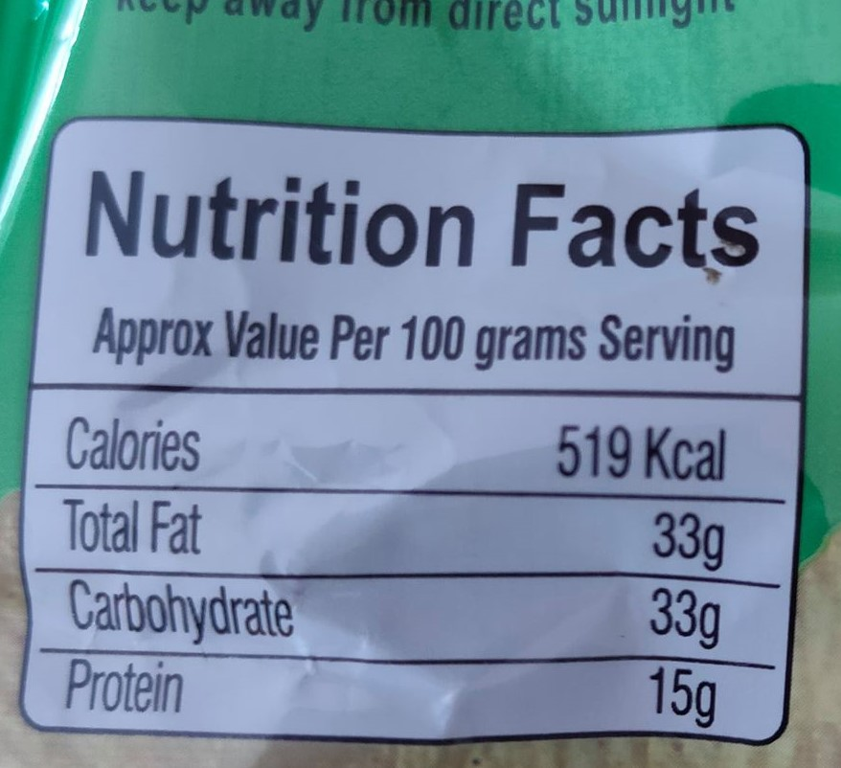
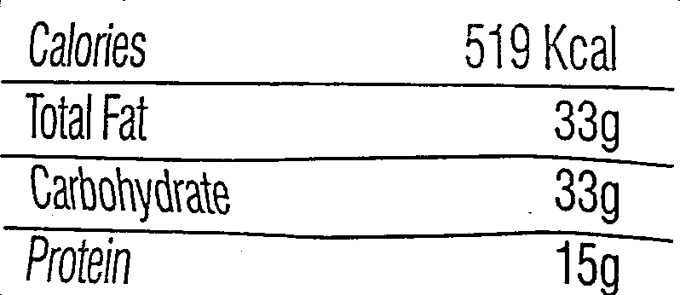
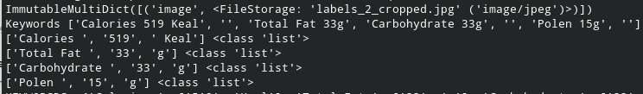
Image Scanning
Image Processing and Computer Vision
Pre-processing
Label Extraction
Post-processing

Slide 10
Image Scanning
Pre-processing
Resizing, Graying & Blurring
Histogram Equalization
Contour Identification
Image Thresholding
Perspective Transformation

Slide 11
Image Scanning
Label Extraction
OCR Engine
Tesseract Open-Source Engine

Slide 12
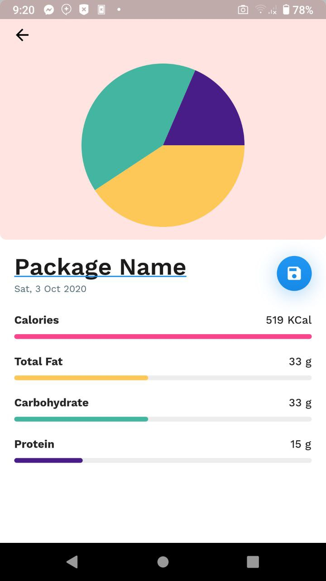
Image Scanning
Post-processing
Decomposition of labels and values
Keyword Matching
Data formatting
Sending over HTTP

Slide 13
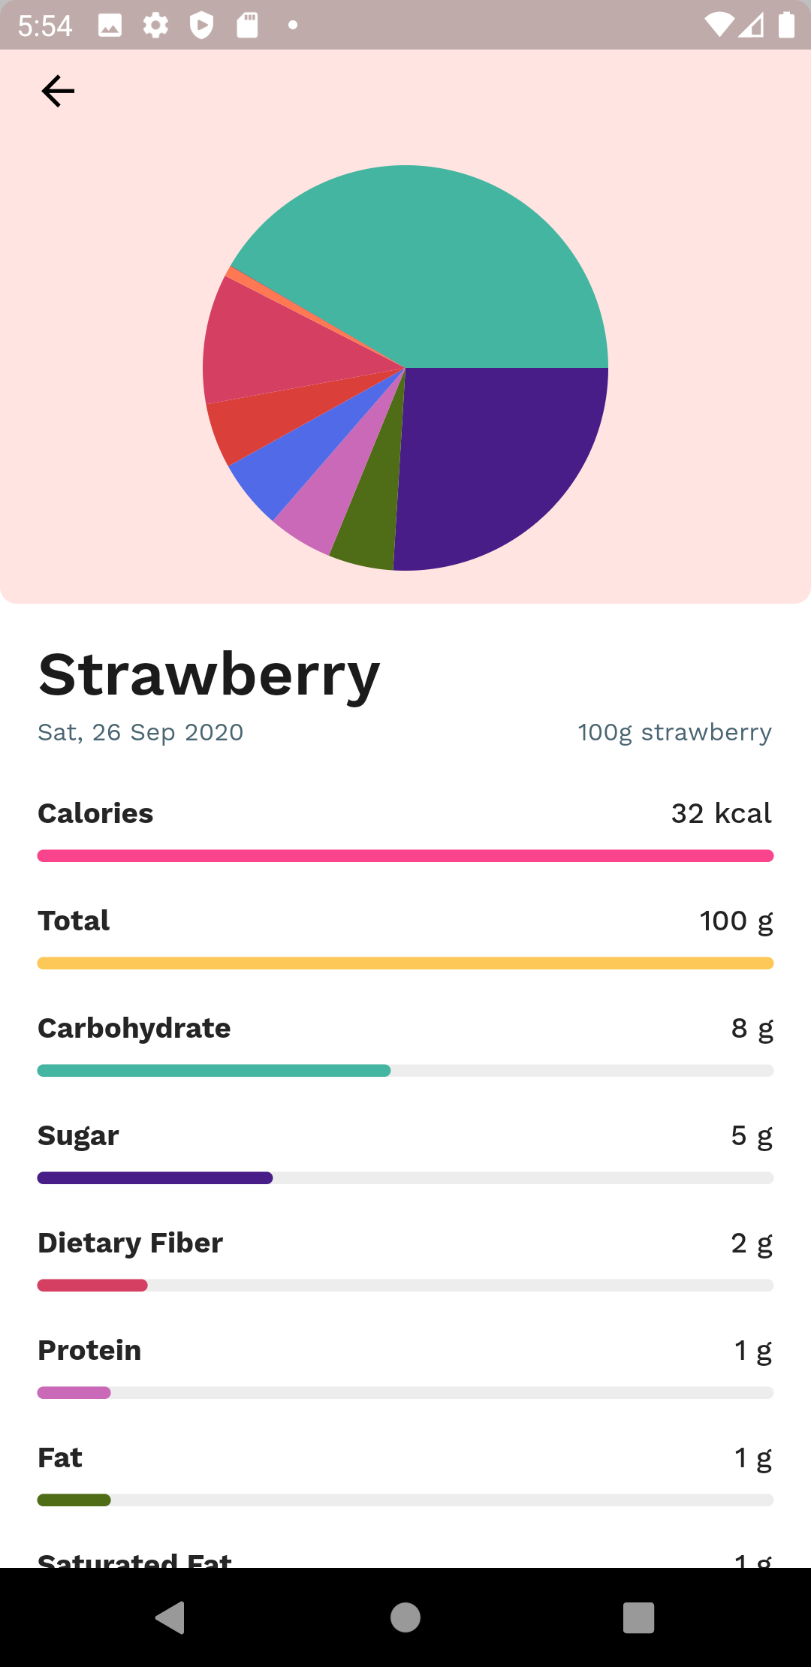
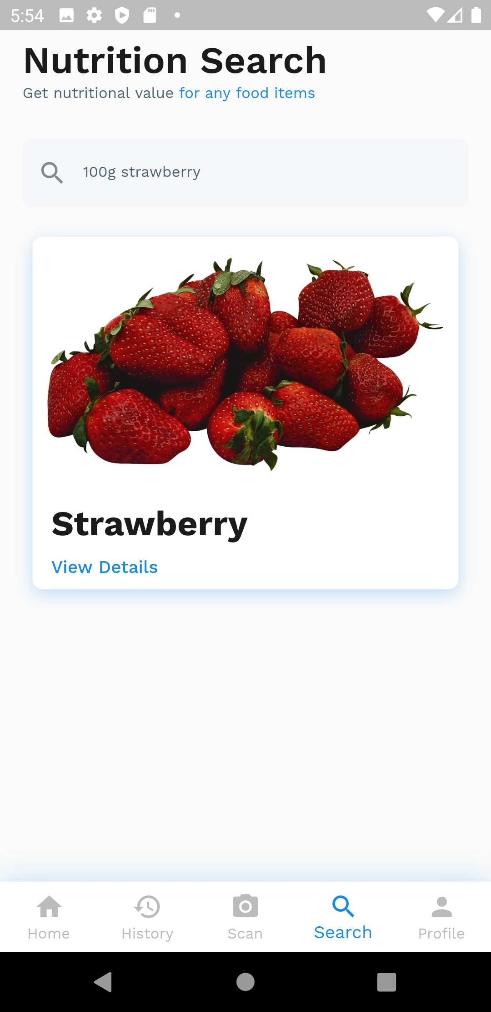
Limitations
Doesn’t respond offline
Search may not show results for all foods.
Recommendation feature is not implemented.
OCR result may contains some error due to technical limitation

Slide 14
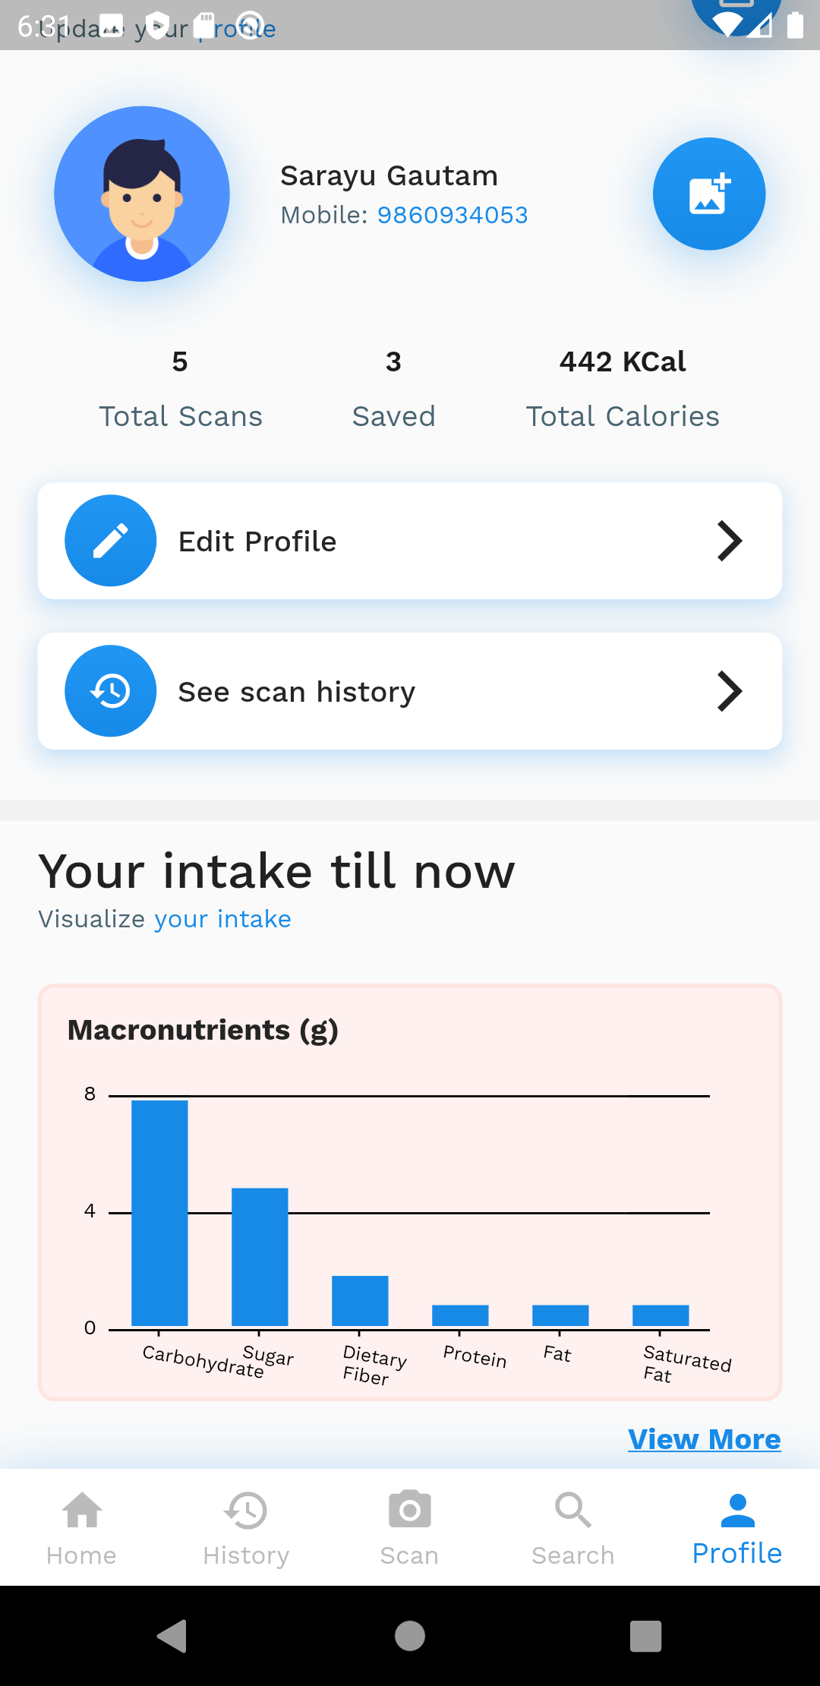
Future Enhancement
Offline functionality
Recommendation based on user scan history
Building our own food search engine
Feature to scan other foods except packaged foods
Enhancing image processing feature without cropping
Add feature to enable user to edit information of scanned item
Optimizing UI/UX based on usability principle

Slide 15
Conclusion
nutri.gram
Scans packaged food items
Visualizes calorific and nutritional information
Provides search feature to search unscanned products
Maintains history of saved scans
Graphically display the scanned information
Provides health tips

Slide 16
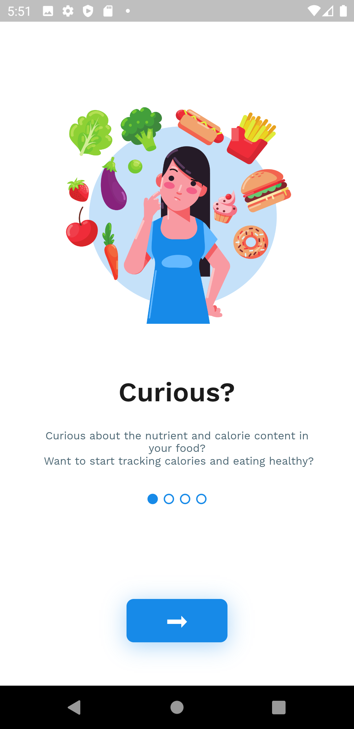
Group Members
Sailesh Dahal (10)
Sarayu Gautam (14)
Bhabin Khadka (23)
Ashish Subedi (53)
Gaurav Singh Thagunna (55)
Stay safe, Stay healthy!

